Slide 1

Happy Farm
SE Team3

Slide 2



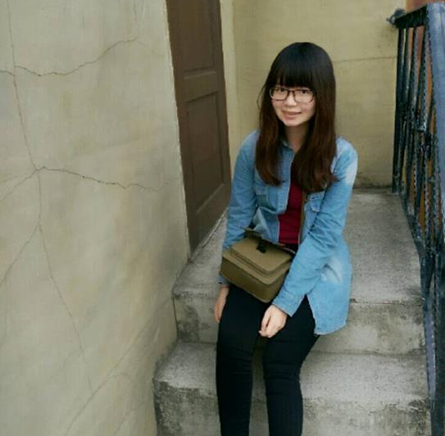
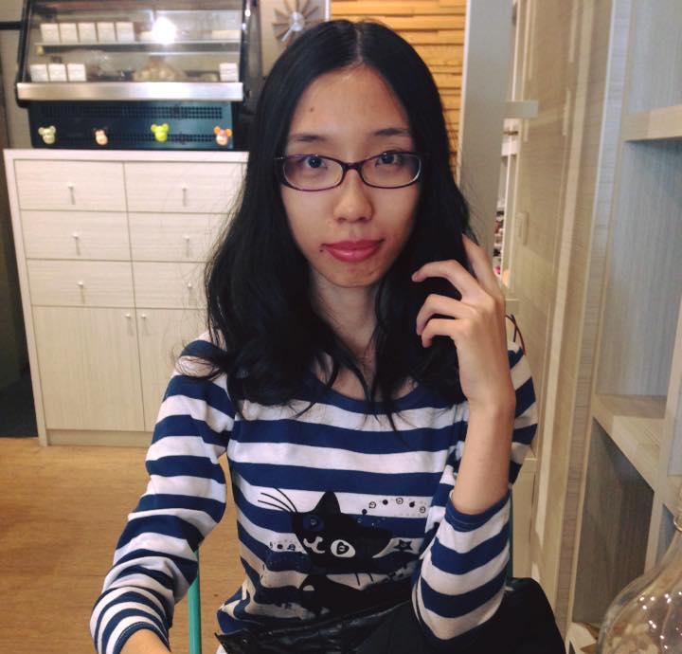
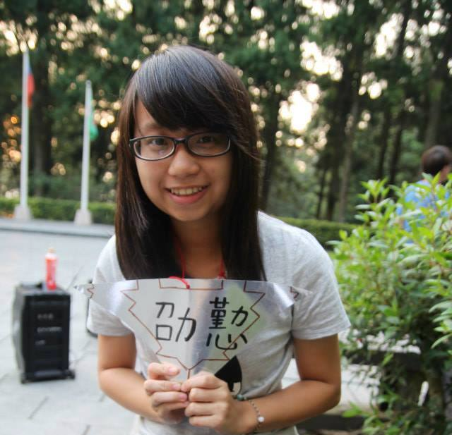
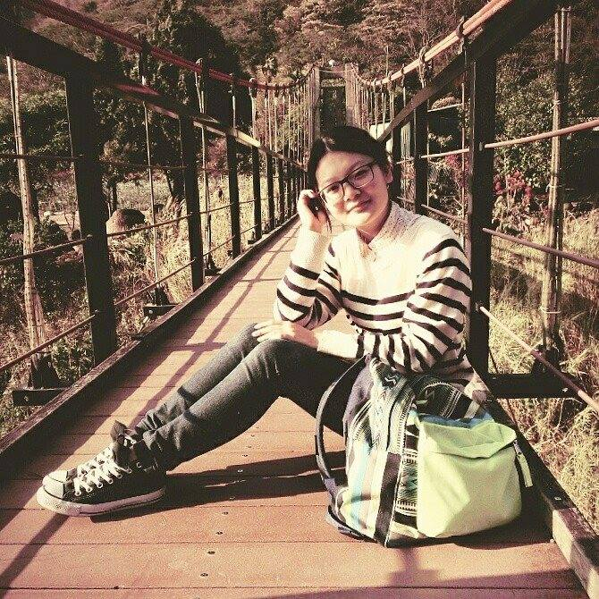

Team Member
Grow
Harvest
Warehouse
Sell
product
102213020 顧晨生
102213001 徐玉兒
102213010 張劭懃
102213044 張怡臻
102213052 卓珈賢
Login
Signup
Teach
Main
Shop
Buy
seed/
land/
energy
CSS
Design

Slide 3


Contents
Use Case
DFD
Class Design
Demo

Slide 4
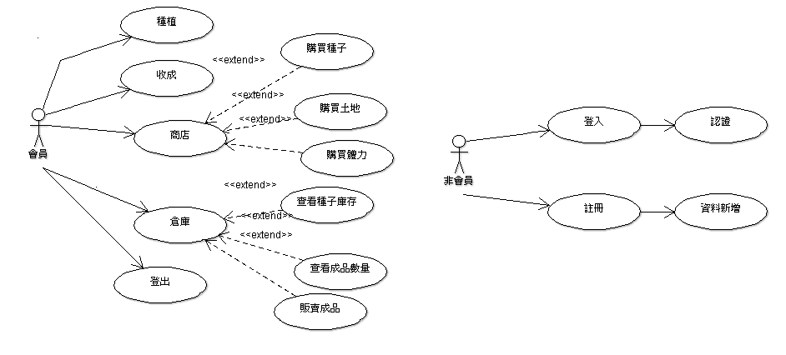
Use Case

Slide 5
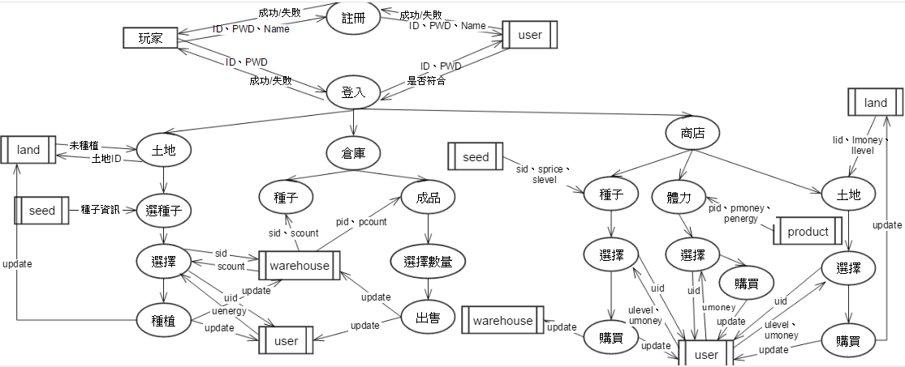
DFD

Slide 6
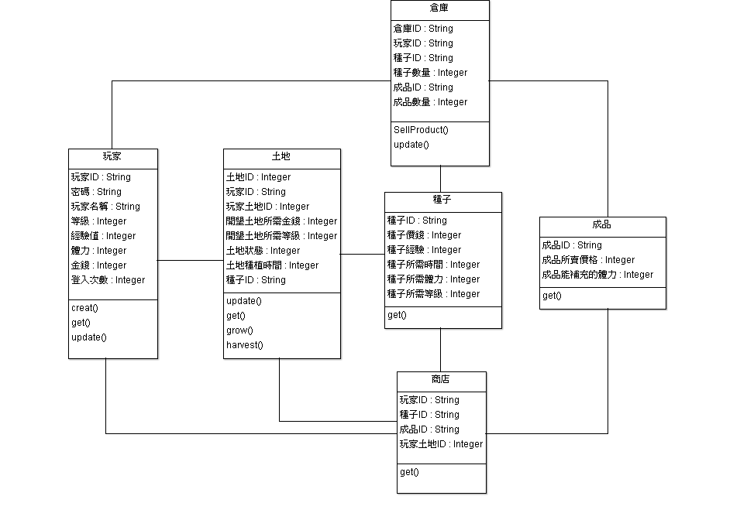
Class Diagram
1
1
n
n
1
n
n
n
n
n
n
1
1
1

Slide 7
DEMO

Slide 8

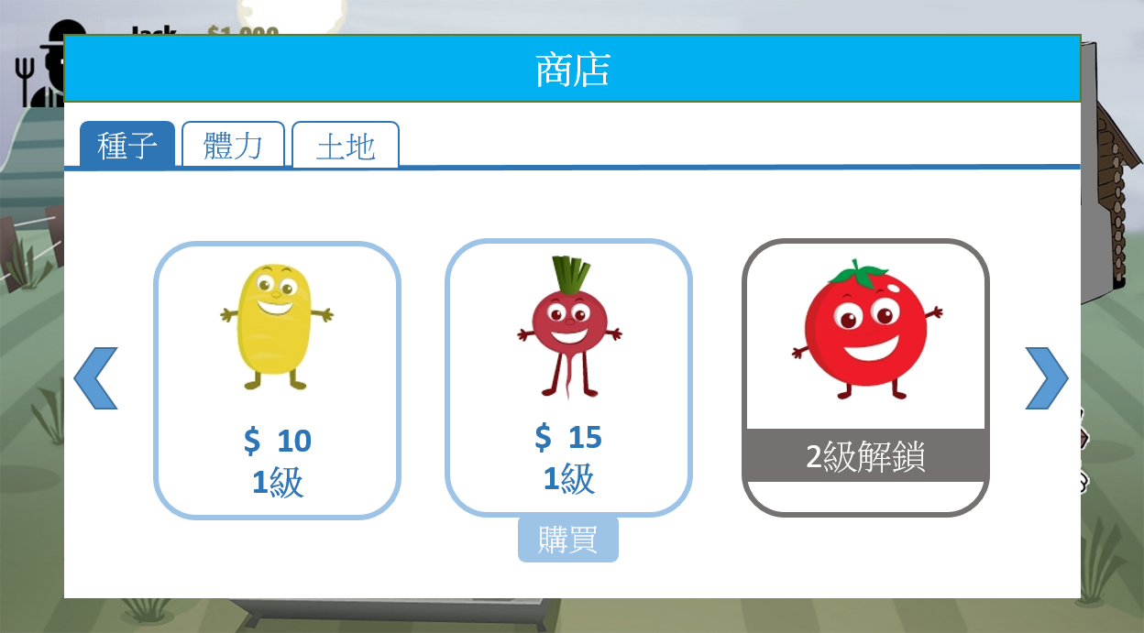
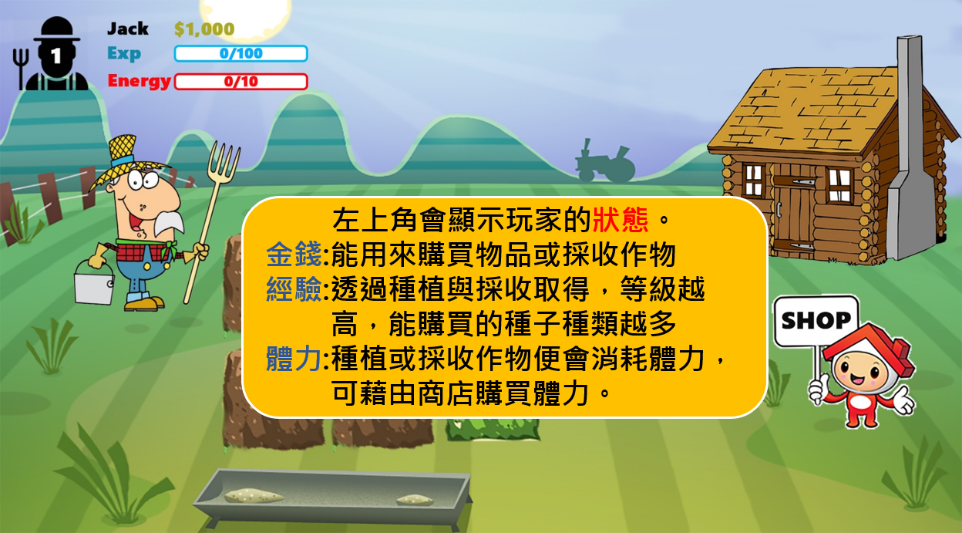

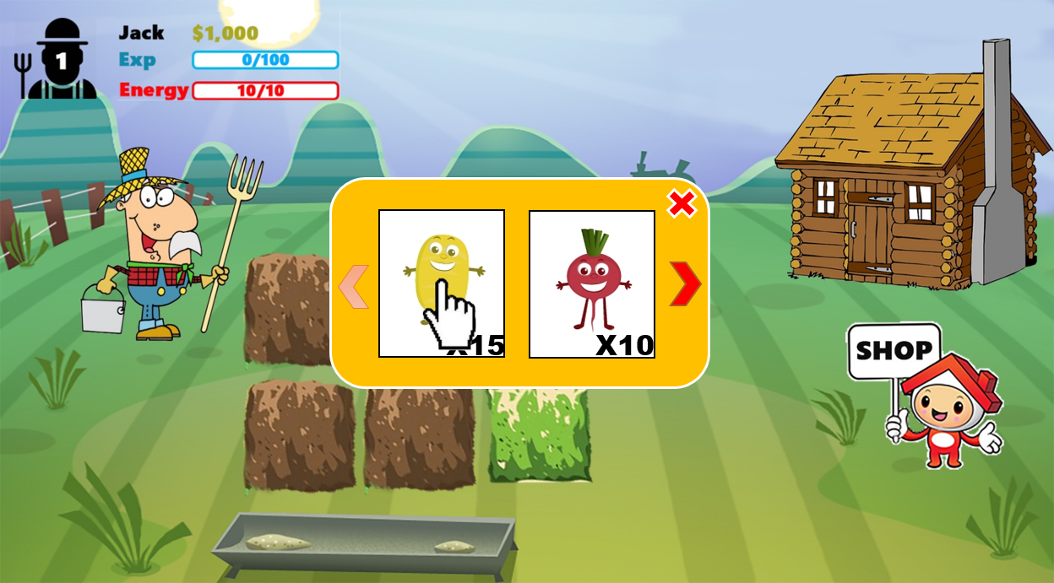
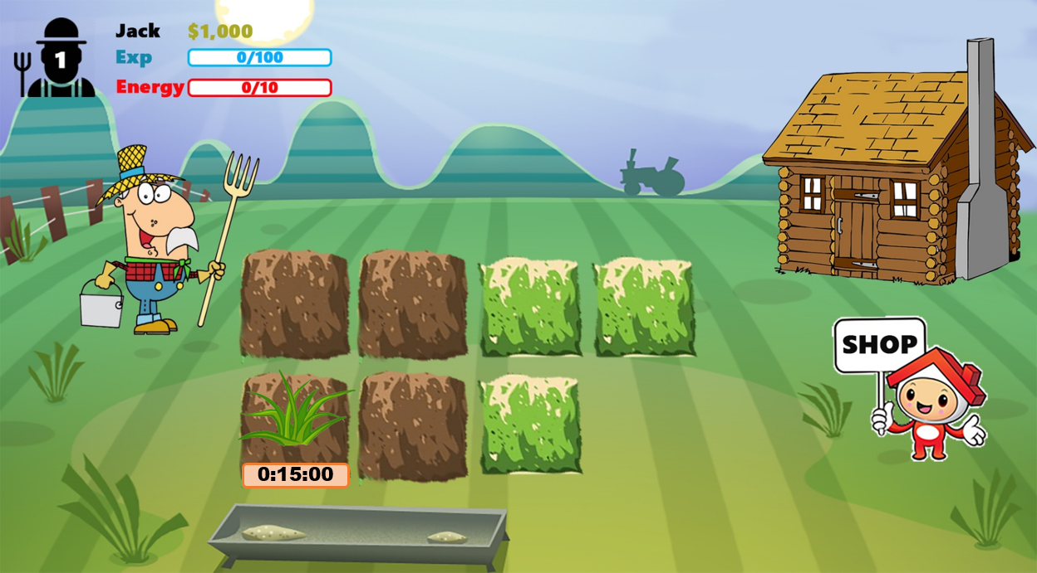
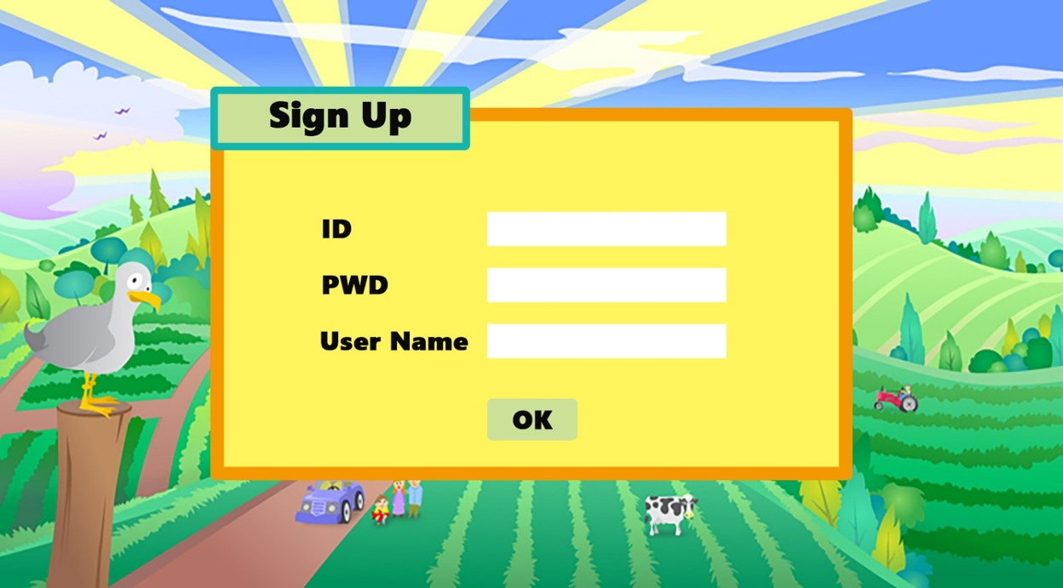
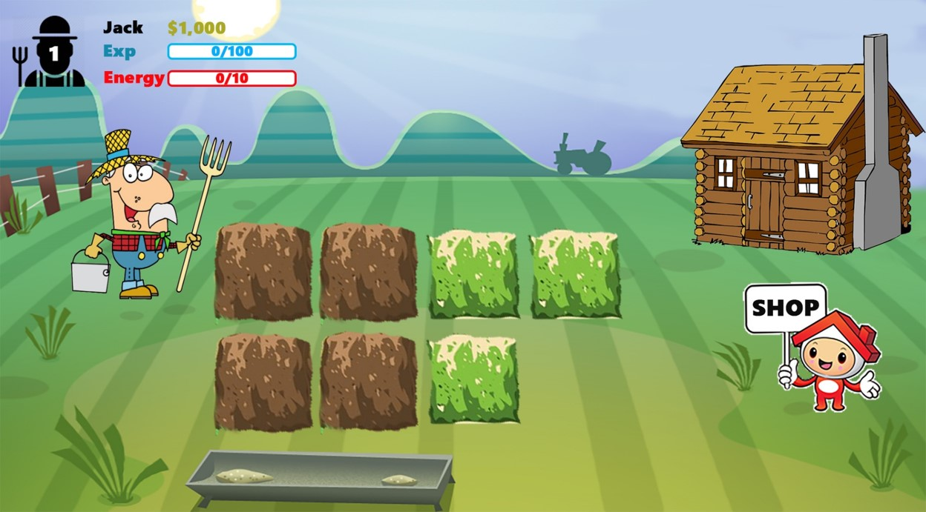
Special Features
User Friendly
Similar to the Prototype

Slide 9
In the Future…
High cohesion & Low coupling
Simplify
Special Effects

Slide 10

Thank You

